Slide 1
CS143 Midterm Practice
Jia(Jason) Teoh
Slides borrowed and modified from Ariyam Das

Slide 2
SQL Practice
Consider the following schema about students and courses. Primary keys are underlined.
Students (sid, sname, street, city, age, gender)
Registered (sid, cid, grade)
Courses (cid, cname, profname)
Note that all of the SQL queries in parts a and b (next two slides) are syntactically valid
Notes:
Recall: primary keys mean unique identifiers for the row
syntactically valid -> don't worry about checking if they fail to compile
[jteoh: Adding credit where due] UC Berkeley CS186 Midterm 2, Spring 2011: https://tbp.berkeley.edu/exams/3215/download/

Slide 3
a) Which of the following queries produces the CIDs of courses that have no registered students? (One or more options are correct)
A. SELECT c.cid
FROM Courses c LEFT OUTER JOIN Registered r ON c.cid = r.cid
HAVING COUNT(*) > 0;
B. SELECT cid FROM Registered
EXCEPT
SELECT cid FROM Courses;
C. SELECT cid FROM Courses
WHERE cid IN
(SELECT cid FROM Registered
GROUP BY cid HAVING COUNT(*) = 0);
D. SELECT c.cid FROM Courses c
WHERE NOT EXISTS
(SELECT cid FROM Registered r WHERE r.cid = c.cid);
E. None of the above
Answer: D
Schema
Students (sid, sname, street, city, age, gender)
Registered (sid, cid, grade)
Courses (cid, cname, profname)
Notes:
[jteoh: Adding credit where due] UC Berkeley CS186 Midterm 2, Spring 2011: https://tbp.berkeley.edu/exams/3215/download/
Answer: D
A: no: Any filled courses will still show up in the join result. COUNT(*)>0 is always true. Small note: HAVING here is used bc aggregate, some systems will still allow you to use COUNT(*).
B: no: This is actually backwards table order – we want courses with nobody registered! this query would give us registered tuples for which the course doesn’t exist.
C: no: this almost works, but grouping by cid doesn’t magically pull in missing cids (and empty classes would be missing from Registered).
D: Yes! This works by checking if there are matching tuples in Registered.
E: no simply because one of A-D is true.

Slide 4
b) Which of the following queries are equivalent to the query: SELECT DISTINCT profname FROM Courses (One or more options are correct)
A. SELECT profname FROM Courses GROUP BY profname;
B. SELECT profname FROM Courses
UNION SELECT profname FROM Courses;
C. SELECT DISTINCT profname FROM Courses
UNION ALL SELECT profname FROM Courses
D. SELECT DISTINCT profname FROM Courses WHERE NULL = NULL
E. None of the above
Schema
Students (sid, sname, street, city, age, gender)
Registered (sid, cid, grade)
Courses (cid, cname, profname)
Answer: A, B
Notes:
[jteoh: Adding credit where due] UC Berkeley CS186 Midterm 2, Spring 2011: https://tbp.berkeley.edu/exams/3215/download/
Answer: A, B
A: group by will only return distinct groups, and we don’t output any other columns
B: UNION is a set operator and will remove duplicates
C: UNION ALL is used to retain all tuples (duplicates) since UNION is a set operator. The second half doesn’t use distinct.
D: NULL = NULL evaluates to NULL (might be false on some systems, but same result)
intuitively: NULL isn’t an actual value, it’s something unknown or inapplicable. We can’t say for certain that two unknowns are equal.
E: duh.

Slide 5
c) When would the following two queries return different results for a given database instance? A one sentence answer should be sufficient!!!
SELECT s.sname FROM Students s LEFT OUTER JOIN Registered r ON s.sid = r.sid
SELECT s.sname FROM Students s, Registered r WHERE s.sid = r.sid
If a student is not registered for a course.
Schema
Students (sid, sname, street, city, age, gender)
Registered (sid, cid, grade)
Courses (cid, cname, profname)
Notes:
[jteoh: Adding credit where due] UC Berkeley CS186 Midterm 2, Spring 2011: https://tbp.berkeley.edu/exams/3215/download/
First query is a left outer join
Second is basically an inner join

Slide 6
d) In the space below, write a SQL query that returns the name and SID of every student enrolled in the class ‘CS186’ whose age is greater than the average age of all the students enrolled in that class. (‘CS186’ is a CID.)
One solution with subqueries (more in slide notes):
SELECT S.sname, S.sid
FROM Students S, Registered R
WHERE S.sid = R.sid AND R.cid = ‘CS186’ AND
S.age > (SELECT AVG(S2.age)
FROM Students S2, Registered R2
WHERE S2.sid = R2.sid AND R2.cid = ‘CS186’)
Schema
Students (sid, sname, street, city, age, gender)
Registered (sid, cid, grade)
Courses (cid, cname, profname)
Notes:
Those of you confused: CS186 is the course number for databases at UC Berkeley where this question was taken from
Many other options, but you’ll need a subquery to compute the avg for sure:
Multiple equivalent solutions exist here: for example you could use JOIN _ ON _ syntax (you’d still need a WHERE clause though).

Slide 7
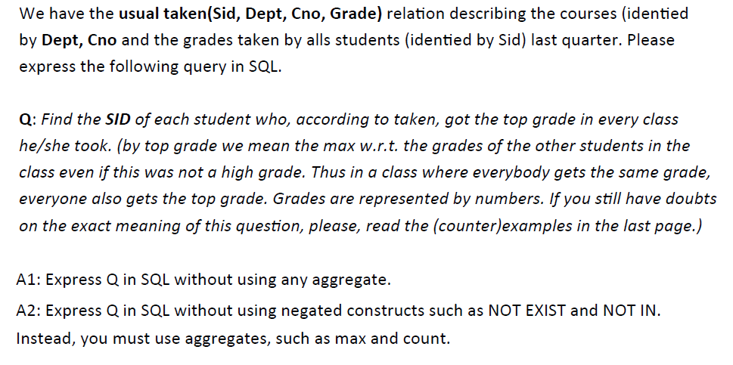
Notes:
In the interest of time we won't get to this one during discussion. Try this one at home!
It might be easier to start with A2 over A1 for some people too.
A1: I think the challenge here is calculating the max GPA - try to use NOT EXIST/NOT IN to replace MAX, such as
select * from taken T1 where NOT EXISTS (select * from taken T2 where T2.grade > T1.grade
You still need to make sure they got the highest grade in each of their classes too!!
A2: I think the challenge here is making sure the student is a top student in all classes - try counting how many classes they took and how many they scored top grades in.

Slide 8
Relational Algebra Practice
Recall the schema about students and courses from the previous question:
Students (sid, sname, street, city, age, gender)
Registered (sid, cid, grade)
Courses (cid, cname, profname)

Slide 9
a) In the space below, write a Relational Algebra expression that returns the sid and sname of all students who received an “A” in a course taught by “Hilfinger”.
Schema
Students (sid, sname, street, city, age, gender)
Registered (sid, cid, grade)
Courses (cid, cname, profname)
Notes:
[jteoh: Adding credit where due] UC Berkeley CS186 Midterm 2, Spring 2011: https://tbp.berkeley.edu/exams/3215/download/
You can also ”push down” the selection filter if you wanted (profname on top of Courses, grade on top of registered).
Remember that natural join (no explicit condition) will remove duplicate values automatically – if you use theta join with an explicit condition, you’ll need to specify what column is projected (eg \pi_{S.sid, S.sname}).
You could push down the projection filter to students (and really any non-join/filter columns on registered/courses), but you still need the final projection regardless. Generally we don’t grade for efficiency on RA queries anyways (as in optimizations, don’t go about joining extra tables because you can)
Digression: Prof Hilfinger is the most feared CS teacher at UC Berkeley (at least during my undergrad, and to my knowledge still is). Primarily for his Compilers course, but he also taught Data Structures while I was there and the intro CS class after I left (you can imagine enrollment was low that quarter). He’s also a bit of a troll: if you ask him what will be on the exam, his response is generally “the exam will cover the sum total of human knowledge, with a focus on material presented in lectures and homeworks”. So in that sense... you’re kind of lucky you won’t end up with a random EC question such as the ones at http://people.eecs.berkeley.edu/~hilfingr/collected-problems.pdf
(My personal favorite is “Name a poet much of whose work can be sung to the tune of The Yellow Rose of Texas” because I guessed it right...)
A few other relevant quotes and anecdotes about Hilfinger (paraphrased/from memory):
“Once you stop bleeding you’ll realize you’ve learned a lot” (I can personally attest to this)
“I’m not going to teach you to swim, I’ll just throw you in the water”
“RTFM” (Read The F...ing Manual – used heavily with project specs)
“Throw away your social calendars. You won’t need them”
Every project submitted must pass a style checker. If it compiles but fails the style checker, you can’t even submit.
Berkeley’s big on memes... so of course: https://memegenerator.net/Paul-Hilfinger

Slide 10
b) In the space below, write a Relational Algebra expression that returns the sid of all
students who have taken both CS162 and CS186 (where CS162 and CS186 are “cid”s) but no other courses. Do not use any unnecessary relations.
Schema
Students (sid, sname, street, city, age, gender)
Registered (sid, cid, grade)
Courses (cid, cname, profname)
Notes:
[jteoh: Adding credit where due] UC Berkeley CS186 Midterm 2, Spring 2011: https://tbp.berkeley.edu/exams/3215/download/
Set difference: Find students who have taken each course, intersect them, then remove students who took any other course.
Could do a join on sid instead of the intersect operator too, just be sure to project sid after that.
(CS162 is Operating Systems at UC Berkeley)

Slide 11
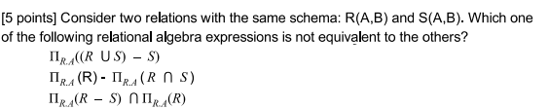
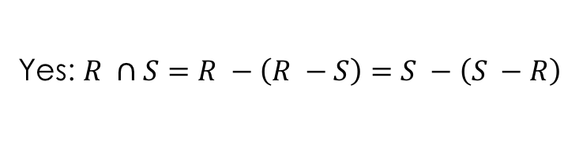
Objective Questions
2nd is different!
(Set diff on R.A)
Can intersection be expressed using set difference?
Can intersection be expressed using cartesian product and projection?
Yes: $R ∩S=R −\left(R −S\right)=S −\left(S −R\right)$
No, neither operator can remove elements! What about empty set?
Can be done if you include selection operator though (MT review sample)
Notes:
Tricky: 1 and 3 are proj_R.A(R – S), but 2 is proj_R.A(R) – proj_R.A(S)
set difference for entire tuple vs A values only
easy example: consider R = {(1, “Hi”)} and S = {(1, “Bye”)}
Thanks to Zijun and the 2A discussion for pointing out my mistake!
intersection as set diff: R – (R – S). R-S means “tuples in R not in S”, so the result is “Tuples in R not in (tuples in R not in S)”. This is equivalent to “tuples in R that are also in S”, which is intersection!
as cartesian product and projection?: Nope. Prof touched upon a similar (same) point in review. Neither Cartesian product nor projection can remove tuples; what if the intersection of R and S is an empty set?

Slide 12
Extendible Hashing
Lecture slide example (index.ppt slide 101)
Recap: Can extendible hashing have overflow? Why or why not?

Slide 13
Extendible Hashing
Does the extendible hash index structure depend on the order in which the keys are inserted?
What about B+-tree?
Not really – matters for order within a bucket only, but not the structure
Yes!! Short example:
Consider leaf node with n = 3 (so 2 keys): [3 4]
When splitting, we keep 2 elements in left node and 1 in right node
Insert 5, then 1:
[3 4 (5)] overflows and becomes [3 4]->[5]
[(1) 3 4]->[5] overflows and becomes [1 3]->[4]->[5]
Insert 1, then 5:
[ (1) 3 4] overflows and becomes [1 3] -> [4]
[1 3] -> [4 (5)] has no overflow: [1 3] -> [4 5]

Slide 14
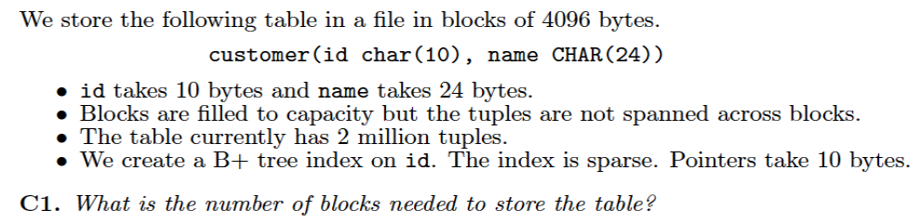
Disk and Indexing
floor(4096/(10+24)) = 120 tuples per block. ceil(2M / 120) = 16667 blocks
fanout: 205; leaves have tail ptr: ceil(16667/(205 – 1)) = 82; root has 82 ptrs -> 83
min = 103 ptrs for both levels: floor(16667/(103-1) = 160, next must be root -> 161
Using B+ tree index as above, how many blocks do you need to read for the following query: SELECT name FROM customer WHERE id = ‘0123456789’
2 (index ) + 1 (file)
Notes:
ALL CALCULATIONS HERE ARE DONE HASTILY AND MAY BE WRONG. logic should be right though.
Tuple = (10 +24)B; floor(4096B/ (34B/tuple)) = 120 Tuples per block
ceil(2M tuples / 120 tuples/block) = 16667 blocks
Minimum number -> best case -> full
fanout: floor(4096+10(key) / (10 + 10)) = 205
leaf nodes have one pointer allocated to tail pointers, so can store 204 data pointers per node.
sparse tree: one pointer per data block (not record!)
leaves: ceil(16667 / (205 – 1)) = 82
Why ceil? because nodes are already at max capacity – any ‘leftover’ requires a new node (and also redistributing from other nodes to reach min requirement)
only one node requires (must be root too, since below min constraint)
TOTAL 82
Min ptrs: leaf = ceil(205 + 1 / 2): 103 (but 103 – 1 data pointers)
non-leaf/root: ceil(205/2): 103
leaves: floor(16667/(103-1)) = 160
floor(160/103) = 1... so has to be the root node.
TOTAL: 161
In both worst and best case, we have 2 levels to get the first leaf node. While not specified, we assume id is unique (ie only one leaf node needs to be retrieved). Thus it’s 2 + 1 (file block).

Slide 15
Dense, Primary Index
Dense Index
Sequential File
10
Primary index (clustering index)
Index on the search key
Dense index
(key, pointer) pair for every record
Find the key from index and follow pointer
Maybe through binary search
Q: Why dense index?
Isn’t binary search on the file the same?
Index require less space and could be load into memory
10
20
20
30
30
40
40
50
60
50
70
60
80
70
90
80
100
90
110
100
120

Slide 16
Sparse, Primary Index
Sparse Index
Sequential File
10
10
20
Sparse index
(key, pointer) pair per every “block”
(key, pointer) pair points to the first record in the block
Q: How can we find 60?
Binary search on sparse index - 50
Load the block
Find 60
30
50
70
30
40
90
110
50
130
60
150
70
80
90
100

Slide 17
Multi-level index
Sparse 2nd level
1st level
Sequential File
10
10
10
What if index size is big?
Build multi-level
1st level: dense/sparse
2nd level or higher level: sparse only
90
30
20
170
50
250
70
30
40
330
90
110
50
410
60
490
130
570
150
70
170
80
190
90
210
100
230

Slide 18
Primary Index vs. Secondary Index
Sequential File
10
30
20
50
30
20
40
70
50
80
60
40
70
100
80
10
90
90
100
60
Notes:
key diff: unordered data

Slide 19
Primary Index vs. Secondary Index
Primary index
Clustering
Tuples in the table are ordered by the index search key
Secondary index
Non-clustering
Tuples in the table are not ordered by the index search key
Index on a non-search-key for sequential file
Unordered file

Slide 20
Sparse and secondary index?
30
30
50
20
80
20
100
70
90
80
...
40
100
10
90
60
Notes:
Doesn’t make sense! What if I were to search for 50?
Jason: Wow, I’m glad you noticed I’m not an artist.
There’s a reason I chose a major that (mostly) doesn’t require picking up a pencil.

Slide 21
Secondary index
10
30
20
50
10
30
40
20
50
70
90
...
50
80
60
sparse
High level
40
70
...
100
10
1st level: dense only
2nd level or higher level: sparse only
90
60

Slide 22
Store table into disk
We want to store the table created by the following SQL statement into a disk.
CREATE TABLE Class(
dept CHAR(2),
cnum INTEGER,
sec INTEGER,
unit INTEGER,
year INTEGER,
quarter INTEGER,
title CHAR(30),
instructor CHAR(20)
)
We need to store tuples for 1,000 classes that have been offered so far. 10 classes are offered every year. The tuples are stored in random order (i.e., they are not sequenced by any attribute).
Notes:
This is HW3 Q1, so skim at best.

Slide 23
Store table into disk
Assume one disk block corresponds to one disk sector. How many disk blocks are needed to store the above table with 1,000 tuples?
tuple: 2+4*5+30+20=72bytes/tuple
block: (1024bytes/block)/(72bytes/tuple)=14tuples/block
table: (1000tuples/table)/(14tuples/block)=72blocks/table
Notes:
HW3 Q1c

Slide 24
Table Size vs. Index Size
10,000,000 records (900-bytes/rec)
4-byte search key, 4-byte pointer
4096-byte block. Unspanned tuples
Q: How many blocks for table (how big)?
floor(4096/900)=4 tuple/block
ceil(10,000,000/4)=2,500,000 block = 2.5 M block
2.5M block * 4KB/block = 10 GB
Q: How many blocks for dense index (how big)? Worst-case
4+4=8 byte/entry
floor(4096 + 4/8)=512 fanout.
Leaves have minimum 257 pointers. Non-leaf has 256
floor(10,000,000/(257 – 1))= 39062 leaf node blocks
floor(39062 / 256) = (...) 1st level node blocks
End: # of total index blocks * 4KB/blocks
Notes:
(Jason fixed second question from previous slides)

Slide 25
Good Luck
Good Luck

